Slide 1

Faculty of Engineering and Technology
Department of Artificial Intelligence & Machine Learning
Notes:
This is the title slide for respective colleges/institutions while we retain the DMIHER logo on top always.

Slide 2

PRESENTATION
A Privacy-Preserving Federated XGBoost Framwork for Proactive Patient Readmission Management
NAME OF SCHOLAR: NAYAN JIKAR
NAME OF THE SUPERVISOR: DR. ASADULLAH
DEPARTMENT OF ARTIFICIAL INTELLIGENCE & MACHINE LEARNING
FACULTY OF ENGINEERING AND TECHNOLOGY, DMIHER (DU), SAWANGI (MEGHE) , WARDHA
DATE :28/01/2025

Slide 3
PRESENTATION OF MAJOR PROJECT II

Slide 4
CONTENTS
Introduction
PRISMA CHART
Literature survey and Research gap analysis
Summary of Research Gap
Research Question
Aim
Objectives
Methodology
PROGRESS
RESULTS
CONCLUSION
REFERENCES

Slide 5
Introduction
Hospital readmission is a critical burden that escalates healthcare costs and signals gaps in patient recovery and post-discharge care.
This project leverages advanced Machine Learning to forecast readmission risks by identifying patterns within Electronic Health Records (EHR).
The system evaluates a combination of medical history, demographic data, and clinical factors to pinpoint the primary drivers of patient relapse.
By enabling proactive and personalized interventions, the framework supports hospitals in reducing costs and improving the overall quality of patient outcomes.

Slide 6
Advantages
Advantages from the Hospital’s Point of View
Aspect | Benefit to Patients | Explanation
1.Regulatory Compliance | GDPR & HIPAA Alignment | Federated Learning bypasses the legal complexities of sharing raw patient data, ensuring full compliance with privacy laws.
2.Operational Efficiency | Customized care based on risk scores | By predicting readmissions, hospitals can allocate beds and staff to patients who need the most post-discharge monitoring.
3.Financial Health | Cost Reduction | Lowering readmission rates prevents financial penalties and reduces the massive costs associated with treating recurring cases.
4. Collaborative Intelligence | Builds confidence in hospital care | Hospitals benefit from a global model trained on vast, multi-institutional datasets without compromising their own competitive data.

Slide 7
Advantages
Advantages from the Patient’s Point of View
Aspect | Benefit to Patients | Explanation
1. Data Privacy | Absolute Confidentiality | Patient records never leave the local hospital database, eliminating the risk of data leaks during transit.
2. Personalized Care | Tailored Treatment | Predictions are based on models that "learn" from diverse populations, offering more accurate, individualized risk profiles.
3. Outcome Quality | Reduced Relapse | Early identification of high-risk patients leads to better discharge planning and fewer emergency re-hospitalizations.
4.Trust | Enhanced Security | Patients are more likely to share honest medical history knowing their data stays within their trusted local facility.

Slide 8
PRISMA CHART
Initial Identification: n = 50
Duplicates Removed: n = 5
Records Screened:
n = 45
Excluded during Screening: n = 15
Reports Assessed for Eligibility: n = 30
Reports Excluded (with reasons): n = 20 (e.g., lack of specific Machine Learning metrics or missing clinical data).
Final Included Studies: n = 10

Slide 9
LITERATURE SURVEY
Sr.No | Title of the Article Author Year of publication | Focus of Study, Design, Objectives , Method used and Sample size | Findings of the study and their conclusions | Limitation
1 | Diabetes 130-US Hospitals for Years 1999–2008 Clore et al., 2014 | • Focus: Diabetes readmission data • Design: Observational dataset • Objectives: Support ML readmission studies • Method: EHR data collection • Sample Size: ~100,000 encounters, 130 US hospitals | • Standard benchmark for readmission prediction • Includes demographics, diagnoses, drugs, LOS • Suitable for ML healthcare research | • Missing values present • Imbalanced readmission classes • Limited clinical depth (BMI, progression) • US-only data.

Slide 10
LITERATURE SURVEY
Sr.No | Title of the Article Author Year of publication | Focus of Study, Design, Objectives , Method used and Sample size | Findings of the study and their conclusions | Remarks of the Scholar
2 | The 30-days Hospital Readmission Risk in Diabetic Patients: Predictive Modeling with Machine Learning Classifiers Shang et al., 2021 | • Focus of Study: Prediction of 30-day hospital readmission in diabetic patients • Design: Retrospective observational study • Objectives: Identify high-risk patients using ML models • Method Used: Random Forest, Naive Bayes, Tree Ensemble (KNIME) • Sample Size: 100,244 diabetic inpatient records (Health Facts Database). | • Random Forest achieved the highest AUC performance • Admission count, age, diagnosis, LOS, and sex were key predictors • ML models support proactive readmission risk management | • Highly imbalanced dataset (11.22% readmitted <30 days) • Ambiguity between <30 and >30-day readmissions • Public dataset with uncertain quality control.

Slide 11
LITERATURE SURVEY
Sr.No | Title of the Article Author Year of publication | Focus of Study, Design, Objectives , Method used and Sample size | Findings of the study and their conclusions | Remarks of the Scholar
3 | OpenFL: The Open Federated Learning Library Foley et al., 2022 | • Focus: Privacy-preserving federated ML/DL • Design: Open-source FL framework • Objective: Collaborative training without data sharing • Method: Aggregation-based FL, secure RPCs, mTLS, PKI, optional TEE • Sample Size: No fixed dataset; real-world federations (e.g., 71 healthcare sites). | • Achieves performance comparable to centralized learning. • Scalable and secure for real-world deployment. • Enables easy migration of centralized models to FL. | • Limited support for vertical federated learning • Hub-and-spoke topology only (no full P2P). • • Security setup (PKI, mTLS, TEE) increases deployment complexity.

Slide 12
LITERATURE SURVEY
Sr.No | Title of the Article Author Year of publication | Focus of Study, Design, Objectives , Method used and Sample size | Findings of the study and their conclusions | Remarks of the Scholar
4 | Hospital Readmission Risk Predictor for Diabetic Patients Using XGBoost Nareddy K. Reddy et al., IEEE, 2023 | • Focus: 30-day diabetic readmission prediction • Design: ML-based study • Objective: Early high-risk patient identification • Method: XGBoost on EHR data; ROC-AUC, PR, accuracy; Streamlit UI • Sample Size: 100,000+ records (UCI Diabetes 130-US Hospitals) | • Handles high-dimensional EHR data well • Provides real-time risk and probability outputs • Supports clinical decision-making | • US-only dataset • Imbalanced readmission classes • Limited clinical depth • No external validation

Slide 13
LITERATURE SURVEY
Sr.No | Title of the Article Author Year of publication | Focus of Study, Design, Objectives , Method used and Sample size | Findings of the study and their conclusions | Remarks of the Scholar
5 | Addressing Privacy-Preservation in Healthcare Using Federated Learning: A Survey Faria Karamat et al., 2025 | • Focus: Privacy-preserving healthcare ML • Design: Survey study • Objectives: Review FL for healthcare privacy • Method: Survey of FL architectures & encryption methods • Sample Size: Not applicable (review paper) | • FL enables decentralized learning without data sharing • Reduces privacy risks of centralized systems • Encryption improves data protection • Suitable for predictive analytics and personalized care | • High communication cost • Aggregation complexity • Scalability challenges • Limited real-world clinical deployment

Slide 14
Summary of Research Gap
Traditional machine learning requires sensitive patient data to be collected in one central location, which is often impossible due to strict healthcare privacy laws between hospitals.
Current federated learning research often relies on simple linear models, failing to utilize high-performance, non-linear algorithms like XGBoost for complex medical patterns.
Models trained on a single hospital's data often perform poorly elsewhere; there is a lack of scalable frameworks for collaborative learning without raw data exchange.

Slide 15
Summary of Research Gap
Most research remains restricted to retrospective analysis, leaving a gap in real-time risk prediction and its seamless integration into active hospital management systems.

Slide 16
RESEARCH QUESTION
How can a privacy-preserving Federated XGBoost framework be implemented to accurately predict patient readmission risks while maintaining strict healthcare data confidentiality across decentralized institutions?

Slide 17

AIM
To develop a privacy-preserving Federated Learning framework that utilizes XGBoost to accurately predict patient readmission risks across decentralized hospital databases without compromising sensitive medical data.

Slide 18
OBJECTIVES
To perform data collection and preprocessing.
To create a federated learning–based system architecture for secure collaborative training
To develop and evaluate a readmission prediction model for decision support.

Slide 19
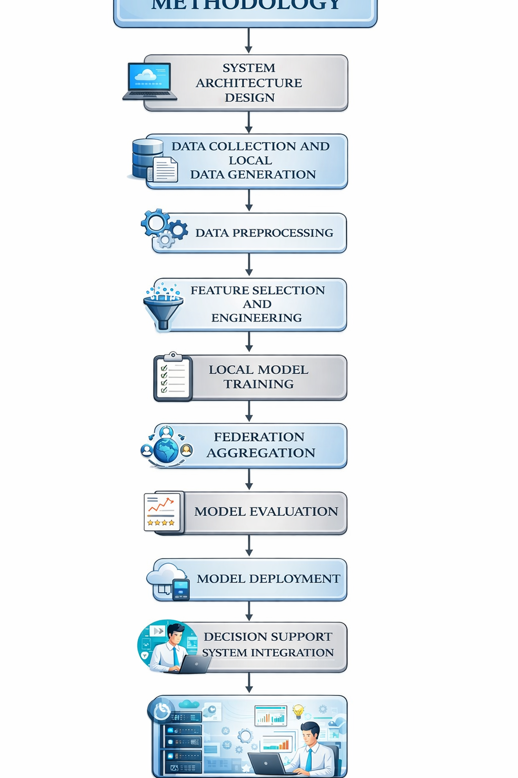
Methodology

Slide 20
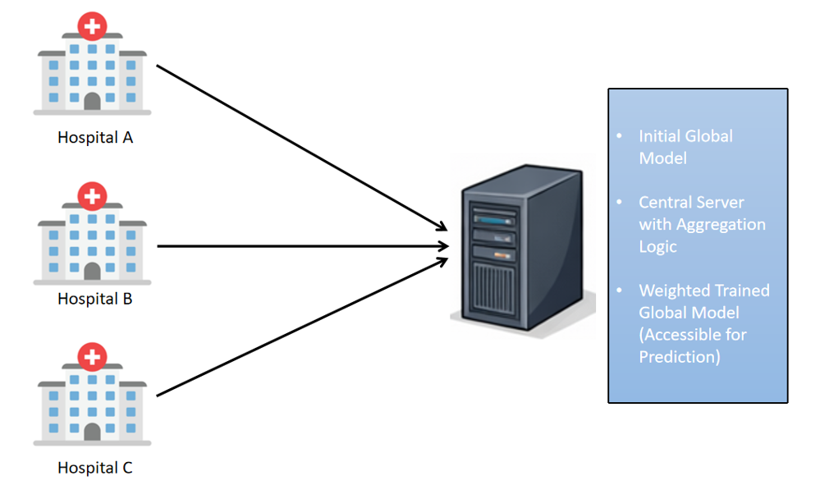

Slide 21
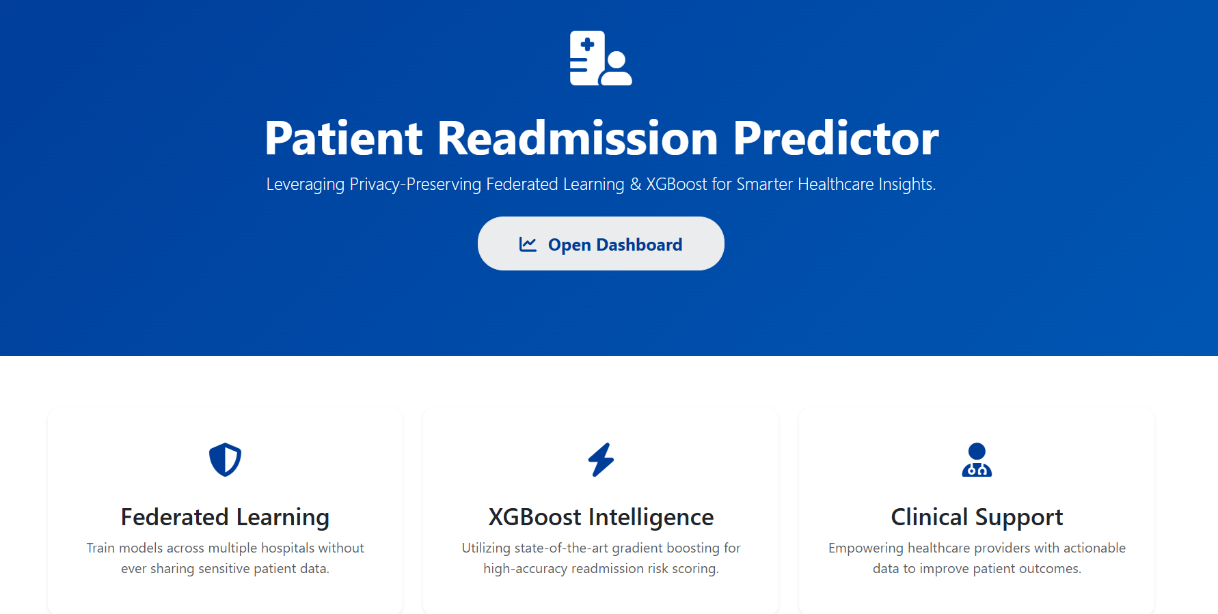
RESULT

Slide 22
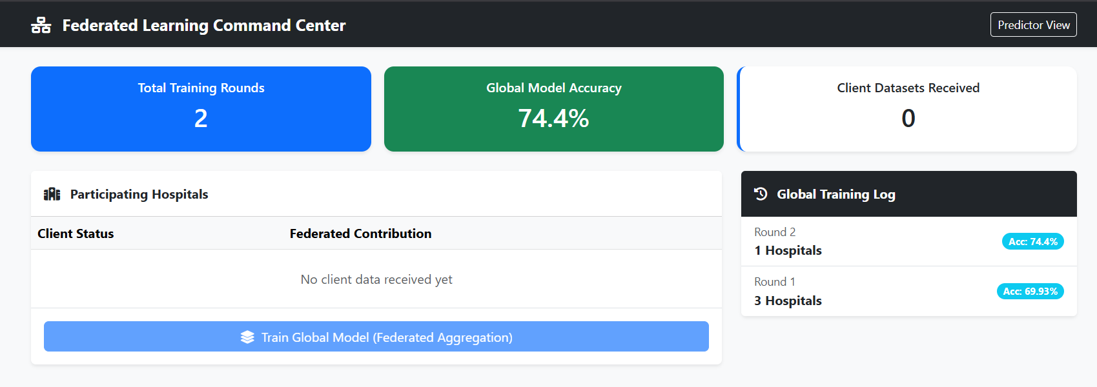
PROGRESS / RESULT

Slide 23
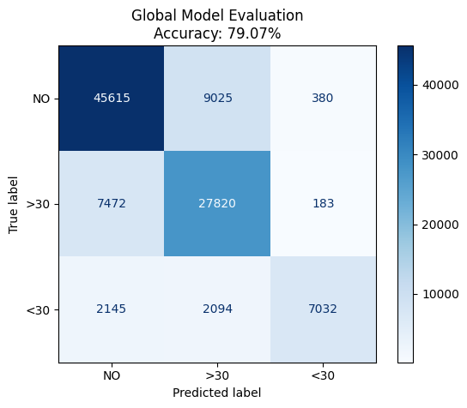
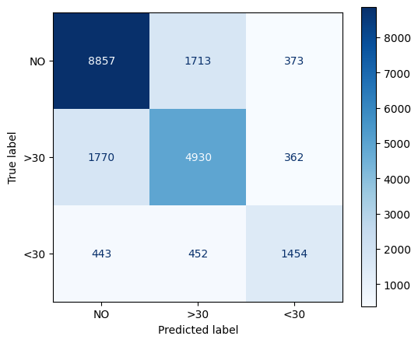

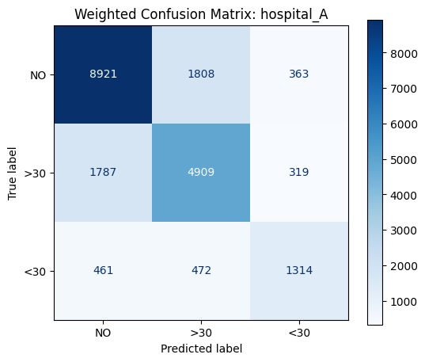
RESULT
Accuracy :74.40%
Accuracy: 74.88%
Accuracy:: 74.75%

Slide 24
CONCLUSION
This project successfully demonstrates the design and implementation of a Privacy-Preserving Federated XGBoost Framework for Proactive Patient Readmission Management. By leveraging federated learning, the proposed framework enables multiple healthcare institutions to collaboratively train a robust predictive model without sharing sensitive patient-level data, thereby addressing critical privacy, security, and regulatory concerns in healthcare analytics.
The experimental results show that the global federated model achieved an accuracy of approximately 79%, outperforming individual local models whose accuracies ranged around 74–75%. This performance improvement highlights the effectiveness of federated aggregation in capturing diverse patient patterns across decentralized datasets while maintaining data confidentiality. The confusion matrix analysis further indicates balanced predictive capability across readmission categories, making the model suitable for real-world clinical decision support.

Slide 25
CONCLUSION
Overall, the framework proves that federated XGBoost is a viable and scalable solution for proactive patient readmission prediction, combining strong predictive performance with privacy preservation. This approach can assist healthcare providers in early identification of high-risk patients, optimize resource allocation, and ultimately improve patient outcomes. Future work may focus on incorporating differential privacy, secure aggregation techniques, and real-time clinical integration to further enhance robustness and deployment readiness.

Slide 26
References
[1] S. Clore et al., “Diabetes 130-US Hospitals for Years 1999–2008,” UCI Machine Learning Repository, 2014.
[2] Y. Shang, X. Zhang, and J. Liu, “The 30-days Hospital Readmission Risk in Diabetic Patients: Predictive Modeling with Machine Learning Classifiers,” Journal of Healthcare Engineering, 2021.
[3] N. K. Reddy, T. Anirudh, T. Varshitha, B. C. Kumar, N. S. S. S. Girish Kumar, and M. A. Jabbar, “Hospital Readmission Risk Predictor for Diabetic Patients Using XGBoost,” in Proc. IEEE Int. Conf. on Computing, Communication and Intelligent Systems, 2023.
[4] P. Foley et al., “OpenFL: The Open Federated Learning Library,” IEEE Software, vol. 39, no. 3, pp. 44–52, 2022.
[5] F. Karamat, A. Rehman, and S. Ali, “Addressing Privacy-Preservation in Healthcare Using Federated Learning: A Survey,” IEEE Access, 2025.

Slide 27
References
[6] S. Davis, J. Zhang, I. Lee, et al., “Effective hospital readmission prediction models using machine-learned features,” BMC Health Serv. Res., vol. 22, no. 1415, pp. 1–12, 2022.
[7] P. Rajpurkar, E. Chen, I. Banerjee, and E. Topol, “AI in health and medicine,” Nat. Med., vol. 28, no. 1, pp. 31–38, 2022.
[8] H. M. Krumholz et al., “Readmission after hospitalization for heart failure among Medicare beneficiaries,” Circulation, vol. 113, no. 17, pp. 2035–2042, 2006.
[9] J. van Walraven et al., “Derivation and validation of an index to predict early death or unplanned readmission after discharge from hospital: LACE index,” CMAJ, vol. 182, no. 6, pp. 551–557, 2010.
[10] D. Kansagara et al., “Risk prediction models for hospital readmission: A systematic review,” JAMA, vol. 306, no. 15, pp. 1688–1698, Oct. 2011.
[11] A. Rajkomar et al., “Scalable and accurate deep learning with electronic health records,” NPJ Digit. Med., vol. 1, no. 18, 2018.

Slide 28
Thank You

